Slide 1
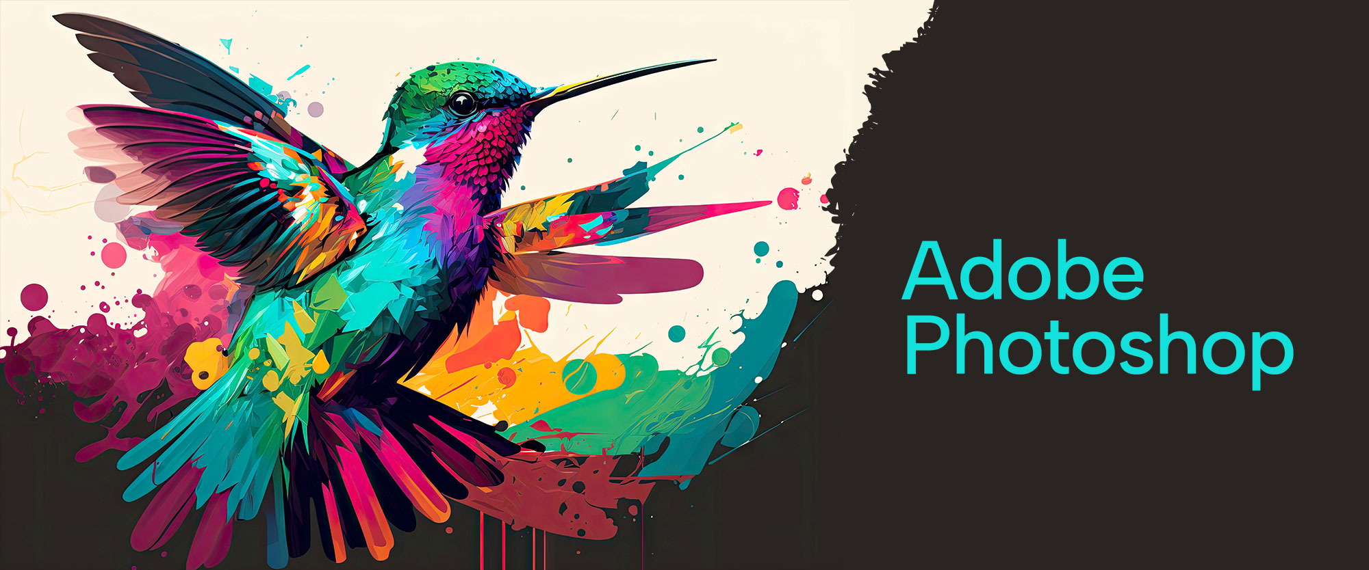

Slide 2
About today…
Image Retouching

Slide 3
Introduction to Image Retouching
What is Image Retouching?
The process of enhancing or correcting images by removing imperfections, adjusting colors, and improving overall quality
Importance of Retouching
Essential for professional photography, marketing, and preserving memories
Common Retouching Tasks
Skin Smoothing
Removing blemishes, wrinkles, and spots
Color Correction
Adjusting hues, saturation, and brightness
Detail Enhancement
Sharpening and clarifying specific parts of the image

Slide 4
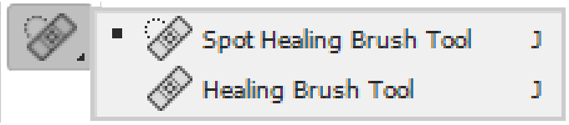

Tools for Image Retouching
Spot Healing Brush Tool
Purpose
Quickly removes blemishes and imperfections by blending them with surrounding pixels
How to use
Click on imperfections to instantly correct them
Clone Stamp Tool
Purpose
Duplicates parts of an image to cover unwanted elements
How to use
Alt-click to select a source area, then paint over the target area
Healing Brush Tool
Purpose
Combines the texture of the source area with the color and luminosity of the target area
How to use
Similar to the Clone Stamp but with more subtle blending

Slide 5
Techniques for Skin Retouching
Frequency Separation
What It Is
Separates the texture and color into different layers, allowing for targeted retouching
Steps
Duplicate the image, apply Gaussian Blur to one layer (color), and High Pass filter to the other (texture). Edit layers independently
Dodge and Burn
Purpose
Enhances the skin by selectively lightening (dodging) and darkening (burning) specific areas
How to Apply
Use a soft brush with low opacity, working on separate layers for non-destructive editing
Removing Blemishes
Spot Healing Tool
Best for quick fixes on small imperfections
Clone Stamp Tool
Ideal for larger areas that need more precise control

Slide 6
Hair and Eye Enhancement Techniques
Enhancing Hair
Steps
Use the Dodge Tool to add highlights and the Burn Tool to add depth and shadows.
Use the Smudge Tool for flyaway hairs
Tips
Work on a separate layer and adjust opacity for natural results
Enhancing Eyes
Brightening the Whites
Use the Dodge Tool on the whites of the eyes to make them pop
Sharpening the Iris
Apply the Sharpen Tool to bring out details in the iris
Adding Catchlights
Create a small white dot or line in the eyes to mimic light reflection, giving the eyes more life

Slide 7
Introduction to Photo Restoration
What is Photo Restoration?
The process of bringing damaged, faded, or old photographs back to life by repairing tears, stains, and discoloration
Importance of Restoration
Preserves historical and personal memories, transforming them into high-quality digital images
Common Restoration Tasks
Repairing Damage
Fixing tears, scratches, and stains
Color Correction
Restoring faded or discolored images to their original tones
Detail Enhancement
Recovering lost details through sharpening and contrast adjustments

Slide 8
Tools for Photo Restoration
Patch Tool
Purpose
Removes larger areas of damage by blending them with surrounding pixels
How to use
Draw a selection around the damaged area and drag it to a clean area to replace it
Content-Aware Fill
Purpose
Automatically fills selected areas with content that matches the surrounding texture and color
How to use
Select the area to be repaired and apply the Content-Aware Fill option from the Edit menu
Clone Stamp and Healing Brush
Application in Restoration
Useful for precise repairs on smaller areas, such as tears, scratches, and blemishes

Slide 9
Repairing Tears and Scratches
Selecting the Right Tool
Small Scratches
Use the Spot Healing Brush or Healing Brush for quick fixes
Larger Tears
The Patch Tool or Clone Stamp is better for covering larger damaged areas
Blending Edges
Feathering Selections
Create soft edges around selections to blend repaired areas smoothly
Smudge Tool
Subtly blend edges to remove visible repair lines
Practical Example
Repairing a torn edge on an old photograph using the Patch Tool and blending the repair with the Smudge Tool

Slide 10
Restoring Faded Colors and Details
Adjusting Colors
Hue/Saturation Adjustment Layer
Boost faded colors or adjust specific color channels
Curves Adjustment Layer
Fine-tune the brightness and contrast to enhance details
Restoring Black and White Photos
Black & White Adjustment Layer
Convert faded images to crisp black-and-white tones
Adding Tint
Apply subtle tints for a sepia or vintage effect
Enhancing Details
Sharpening Filters
Use Unsharp Mask or High Pass filters to recover lost details
Noise Reduction
Apply noise reduction filters to clean up grainy areas without losing detail

Slide 11
Reconstructing Missing Parts
Filling in Missing Areas
Content-Aware Fill
For small missing parts, use this feature to intelligently fill gaps with similar content
Manual Reconstruction
Use the Clone Stamp Tool to manually reconstruct missing details by copying and pasting from other parts of the image
Using Reference Photos
When large sections are missing, use a reference photo or similar images to reconstruct the missing parts accurately
Example
Reconstructing a missing corner of a photograph using manual cloning and Content-Aware Fill

Slide 12
Combining Multiple Techniques for Complex Restorations
Layer-Based Editing
Use multiple layers for different restoration tasks (e.g., one layer for color correction, another for repairing damage)
Non-Destructive Workflow
Always use adjustment layers and masks to keep the original image intact
Blending Modes
Experiment with different blending modes (e.g., Overlay, Multiply) to enhance or restore specific areas
Case Study Example
A complex restoration involving color correction, detail enhancement, and reconstruction of missing parts

Slide 13
Common Mistakes and Tips
Common Mistakes
Over-Retouching
Avoid making the image look unnatural or overly polished
Ignoring Subtle Details
Small imperfections left uncorrected can detract from the overall quality
Destructive Editing
Always work non-destructively by using layers and masks
Tips for Success
Zoom In and Out
Regularly check your work at different zoom levels to ensure consistency
Use a Light Touch
Apply subtle corrections and build them up gradually
Save Progress Regularly
Keep versions of your work to avoid losing progress

Slide 14
Practical Exercise
Task
Restore an old, damaged photograph using the techniques discussed
Instructions
Start with a scanned old photograph that shows signs of damage, fading, or discoloration
Use the Patch Tool and Healing Brush to repair tears and scratches
Apply Hue/Saturation and Curves adjustments to restore faded colors
Reconstruct any missing parts using the Clone Stamp Tool and Content-Aware Fill
Sharpen details and reduce noise for a final polished look
Goal
Achieve a fully restored photograph that looks natural and retains its original charm

